Slide 1
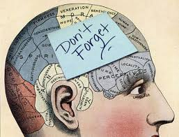
Want to Improve Your memory Strategies? Watch this Video!
PSY 324
Module 3 Presentation 2

Slide 2
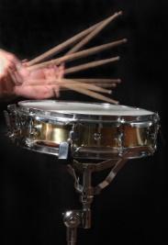
Drum roll please . . .
Ten research- based strategies for
remembering things better!

Slide 3

#10
The total-time hypothesis

Slide 4
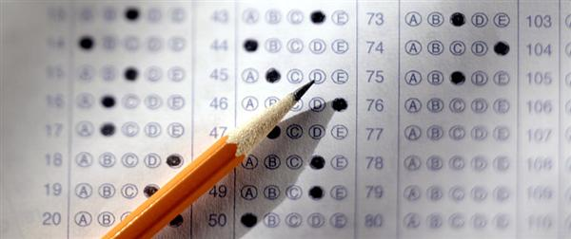
#9
Encoding specificity

Slide 5
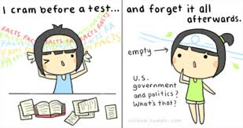
#8
The distributed-practice effect

Slide 6

#7
Working memory

Slide 7

#6
Levels of processing

Slide 8

#5
Mnemonic devices

Slide 9

#4
The self-reference effect

Slide 10
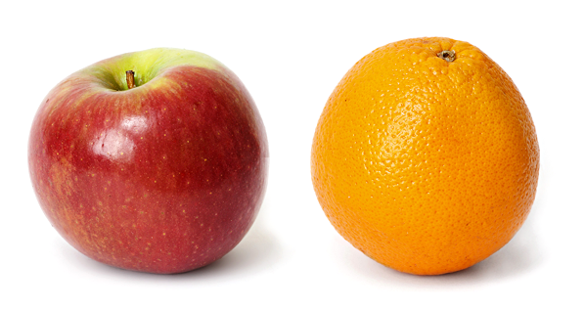
#3
Distinctiveness

Slide 11
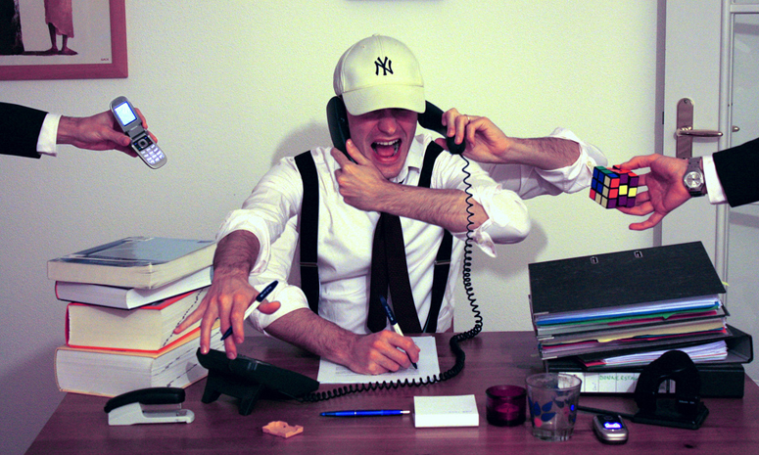
#2
Divided attention

Slide 12

#1
Elaboration

Slide 13

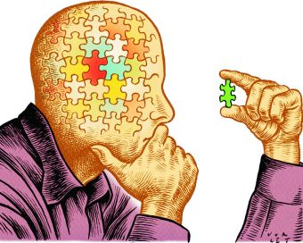
And finally, two strange phenomena . . .
Tip-of-the-tongue
Feeling-of-knowing
Your memory is here

Slide 14
What memory strategies will you try?

